Slide 1
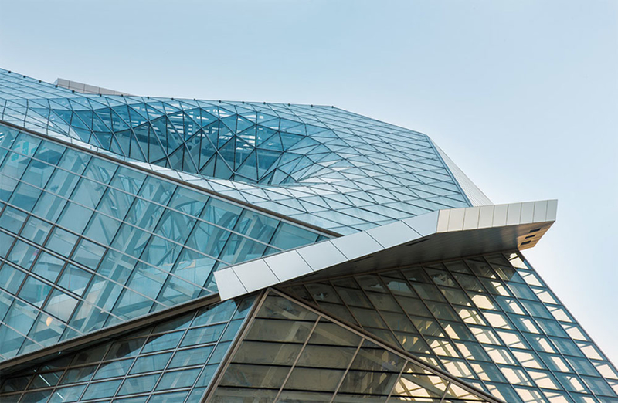

MODERN ENGINEERING GROUP
Established By
Dr.: ADEL ANWAR EID
DBA, B.Sc., AVS, C-Eng. 2002/2

Slide 2
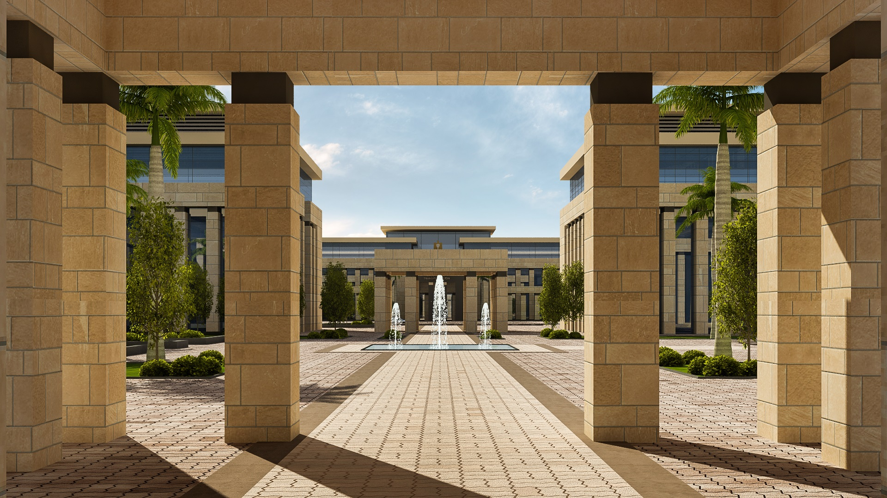
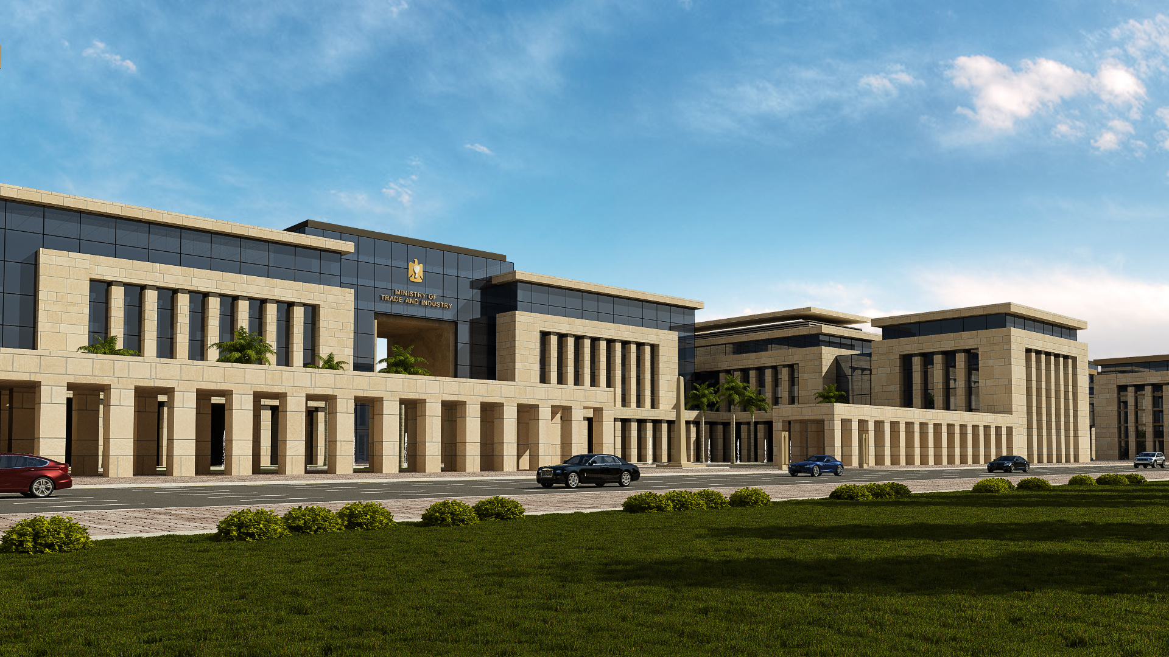
Main Topics
INTRODUCTION TO OUR FIRM
MEG MISSION
MEG VISION
SCOPE OF SERVICES
FAÇADE ENGINEERING
Contributed Values To The Project
Façade Engineer Vs. Design Team
MEG CORE TEAM
OTHER SERVICES COVERED BY MEG
1- System Providers
2- ALUMEG Integrated Façade Systems
3- Categories of Services
4- Engineering's Design Services

Slide 3
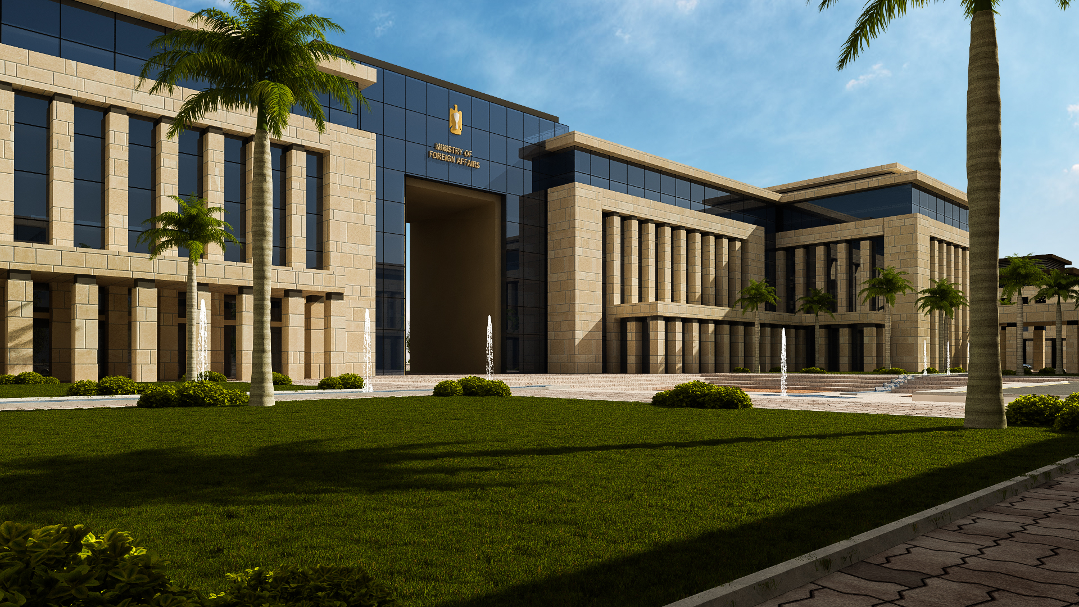
INTRODUCTION

Slide 4
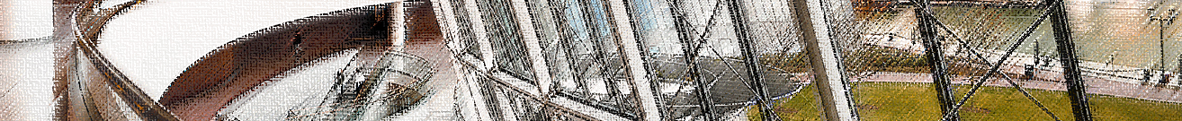
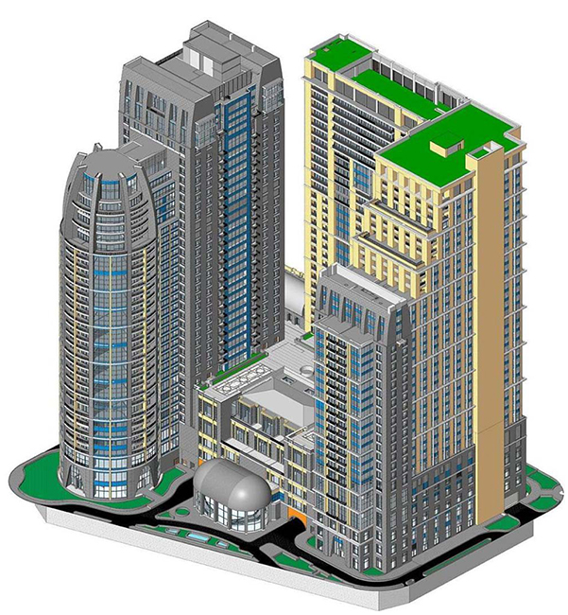
Introduction
Modern Engineering Group (MEG) is a consulting firm started on 1994 as architectural consulting firm with the name of Modern Architecture Group MAG until 2015 the name was changed to Modern Engineering Group MEG to include all engineering disciplines working jointly with prestigious engineering consultancy firms.

Slide 5
Introduction
MEG has an extensive experience in facade engineering gained through working with international companies involving facade construction and design processes such as Ramboll, Whitby & Bird, Arup Façade Department, Meinhardt, Heitmann & Associates, for over twenty five years; introducing new strategies and planning systems that would lead to a decrease in delivery durations; meet or exceed design performance criteria, as well as maintaining the project budget.
Working in projects designed by prestigious consultants such as ZAHA HADID, NORMAN FOSTER, MICHEL GRAVE, NIKKEN SEKKEI, HOK, ATKINS, WATG, WZMH, 5+ Design & KEO according to international codes & standards, including hotels, airports, office buildings, residential compounds, palaces and educational buildings.

Slide 6
Introduction
MEG is currently providing façade consultancy service to varies office buildings in the flourishing business center located in East Cairo at the 90th southern road, owned by banks or major construction local developers in the country.
MEG contributed by publishing several technical articles in international engineering magazines. Hold, manage, and speaker for several international conferences. Partner, prime lecturer of Façade Engineering Professional Diploma for the American University in Cairo, (AUC) the first façade diploma in the MENA region certified by repetitive American Universities. Partner, prime lecturer of Façade Engineering Professional Course at Greek Campaign at American University in Cairo in association with Soic-Infinity.

Slide 7
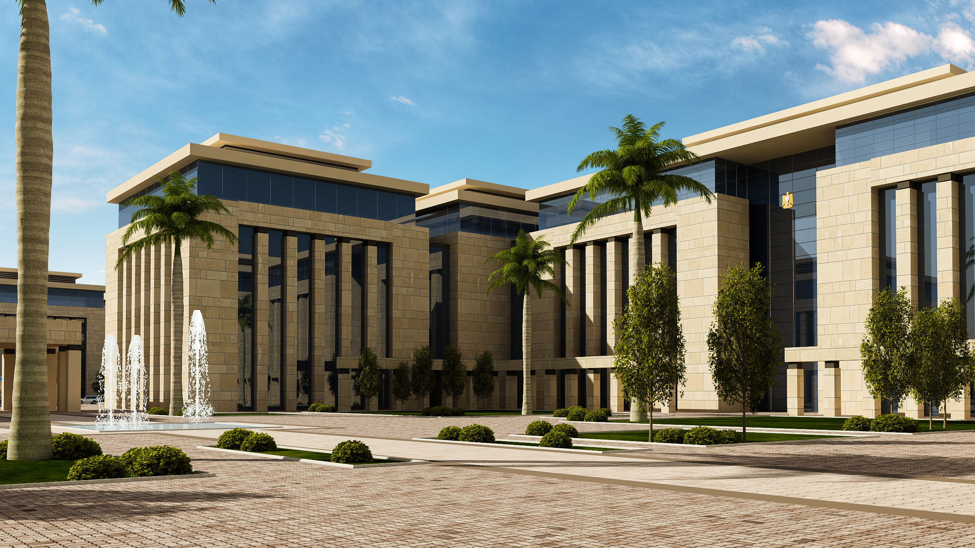
MEG MISSION

Slide 8
MEG Mission
MEG philosophy is embedded in sustainable design principles that include economic, environmental and social factors that apply to all design process. Economic sustainability ensures that all our designs will add value to our clients’ projects and portfolios. In environmental terms we aim to address issues such as zero energy buildings, green building design and construction, low-carbon design, renewable energy, water efficiency, waste minimization, conserve natural resources and self-sufficiency , responsible sourcing of materials and self-sufficiency. Social sustainability ensures the community can benefit from development that respects cultures and traditions. It also means that there are tangible benefits of our projects to the local communities that ensures the success and longevity of the project into the future. MEG Consultancy Firm target to lead our clients’ projects to the best design solutions maintaining a better world for all.

Slide 9
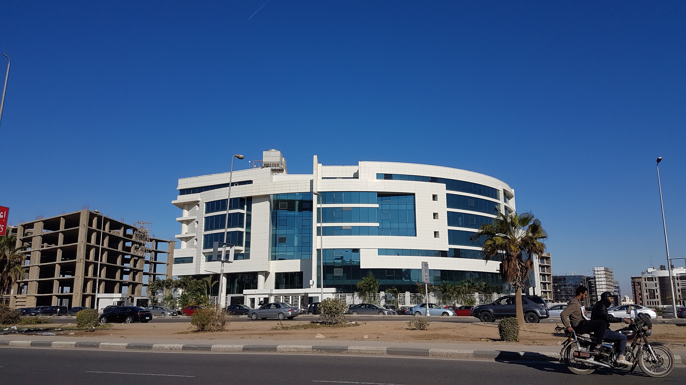
MEG VISION

Slide 10
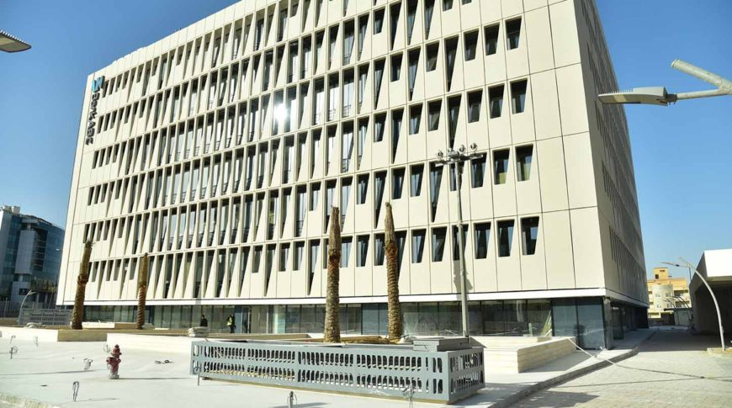
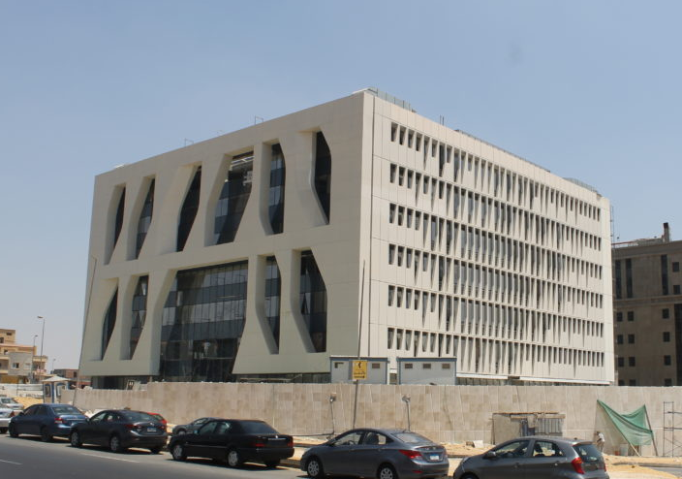
MEG Vision
We aspire to be a progressive leader in the construction industry and to continuously improve the way our engineering is delivered worldwide.

Slide 11
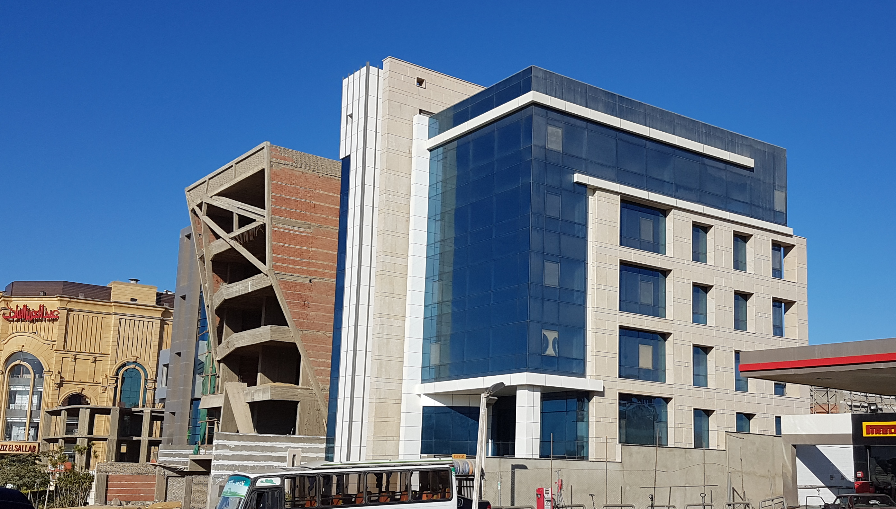
SCOPE OF SERVICES

Slide 12
MEG Scope Of Services
MEG Engineering Consultants concern themselves with everything to do with a building's external envelope above ground level. Such as:
Cladding “aluminum, composite panel, GRP, GRG, GRC, terracotta, HPL, brass & bronze, solid surface, textile membrane, EIFS, wood cladding & ETFE”.
Curtain wall “Conventional, structural glazing, & unitized”.
Stonework “Mechanically fixed, tied by wire, & glued”.
Glass “Frameless, Spider systems “.
Masonry “rated, non-rated, & cladding”.
Roofing systems.
Other finishing materials and cladding types

Slide 13
MEG Scope Of Services
MEG Engineering Consultants consider the performance of such materials and systems in various respects:
Weather tightness.
Structural behavior.
Interaction with the primary structure.
Thermal gains and losses through the façade.
Occupant comfort and energy efficiency.
Shading strategies.
Condensation calculations.
Ventilation.

Slide 14
MEG Scope Of Services
MEG Engineering Consultants consider the performance of such materials and systems in various respects:
Durability.
Sustainability.
Natural light admittance.
Fire behavior of the building envelope.
Acoustic performance.
Safety and serviceability.
Security.
Maintenance and build-ability.

Slide 15
MEG Scope Of Services
MEG Engineering Consultants advice on both existing and new buildings.
MEG can be involved in design, working alongside the architect, QS and structural and mechanical engineers, or can work within contracting or manufacturing.
Alternatively, MEG can be involved in surveying or diagnostic and remedial work as well as involved in research and testing.
Providing façade consultancy service to varies office buildings in the flourishing business center located in East Cairo at the 90th southern road, owned by banks, major construction companies, or famous local developers in the country.

Slide 16
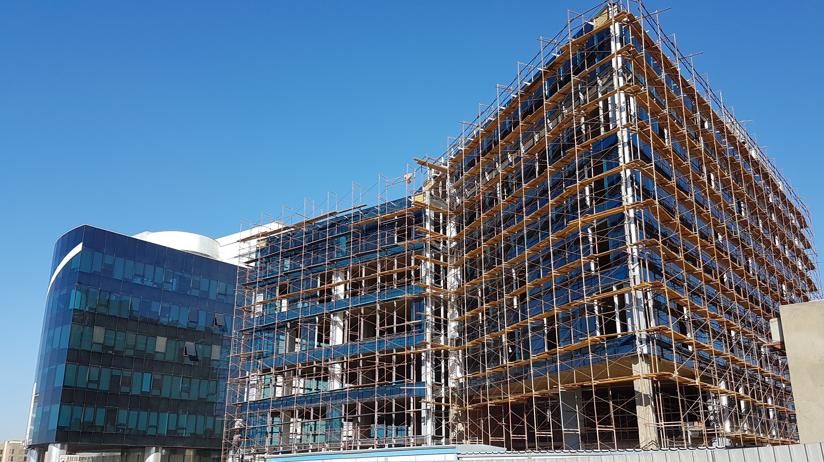
FAÇADE ENGINEERING

Slide 17

Facade Engineering
Façade Engineering is the art of resolving aesthetic, environmental and structural issues to achieve the enclosure of habitable space.
Façade Engineering Society
The Chartered Institution of Building Services Engineers (CIBSE)

Slide 18
Facade Engineering
The façade or exterior envelope of a building is the element that makes the internal space habitable, it acts as a filter allowing in beneficial elements of the external climate in whilst providing a barrier to those less desirable elements. It is often considered to be the highest risk of any project.
Every curtain wall job should have an independent specialist consultant on board. The contractor’s guarantee is valid for at most 10 years, while the owners needs a system which is going to perform properly and look good for at least 30 years.
Premature curtain wall failure means premature building replacement and huge consequential economic loss. That is why prudent clients always seeks MEG consulting firm with their consulting team.

Slide 19
Facade Engineering
Site operations are a core strength of MEG. We develop a custom, comprehensive installation strategy finely tuned to specific project requirements for each new project we undertake.
Constructability review begins early in the design phase -more often than not before we are actually awarded a project- with facade systems designed to facilitate fabrication and installation, and thereby producing optimum economy.
Our strategic pairing of lean manufacturing with just-in-time delivery minimizes the impact of the facade system installation on the building site in regards to both site storage and staging requirements; each a vital consideration for the increasingly dense, urban jobsites common today.

Slide 20
Façade Engineering Contributed Values To The Project
Performance led design. Delivering facades that do what is required of them!
Excellence in design.
Risk control.
Driving cost out.
Continuity through fabrication and installation stages.
Attention to quality as the design becomes a physical reality.
Verifying performance.
Cladding performance when the occupants move into the building.
Troubleshooting when problems occur.

Slide 21
Façade Engineer Vs. Design Team
Facades have become complicated beyond the skills of an architect, structural or mechanical engineers.
Facades require a dedicated engineer with a particular range of skills and experience, who understands their behavior and can undertake their design, manufacture and installation better, more efficiently and more comprehensively than can a traditional architect, structural or mechanical engineer.

Slide 22
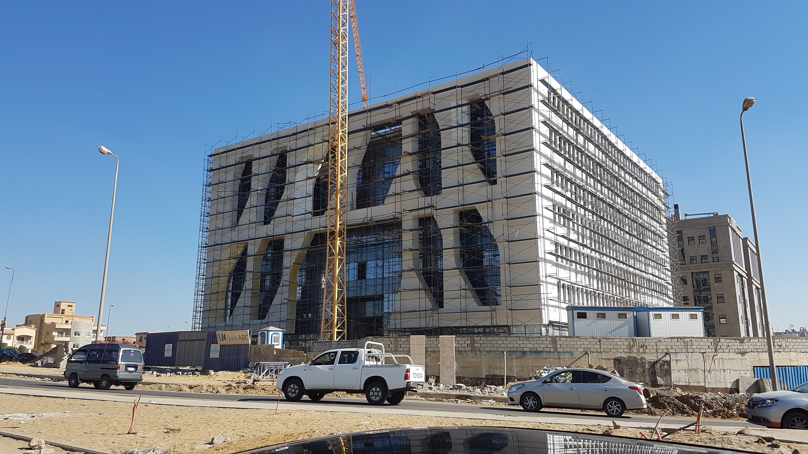
MEG CORE TEAM

Slide 23
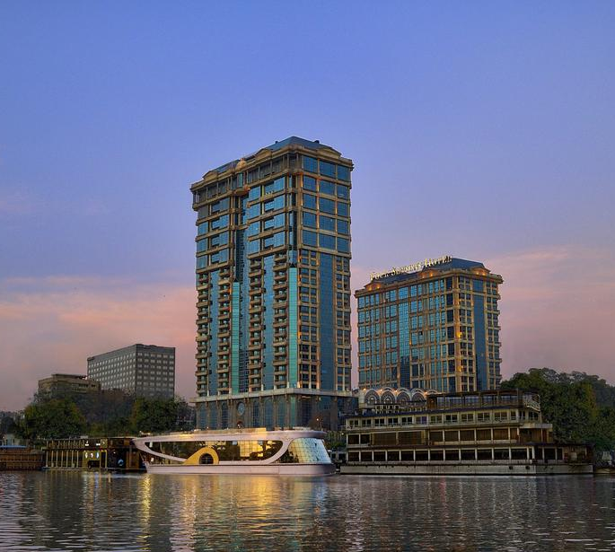
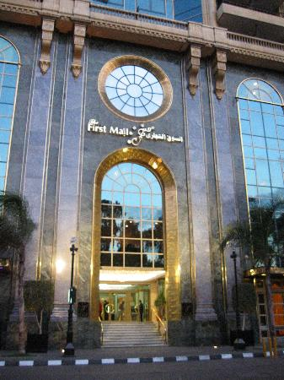
MEG Core Team:
Dr. ADEL ANWAR EID, Chairman
Dr. Adel Anwar Eid granted his architectural engineering certificate on May 1986 and received his architectural consultancy certificate from the engineering syndicates on 2002 in the field of supervision of architectural projects construction, his Master of Business Administration (MBA) on 2014, and his Doctoral of Business Administration (DBA) on 2017 from the international Business School of Scandinavia “IBSS”.

Slide 24
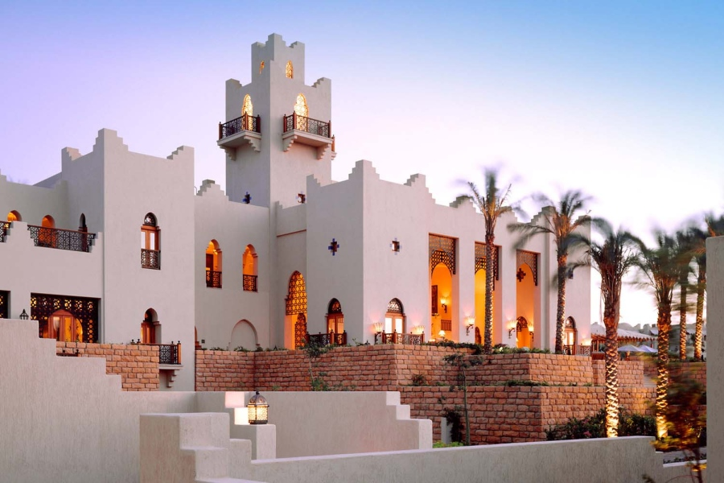
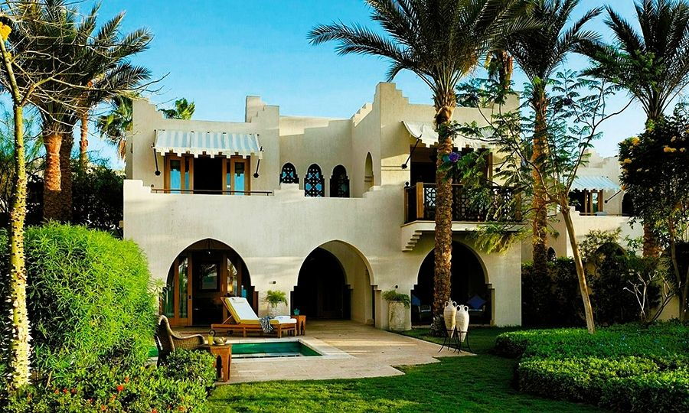
MEG Core Team:
Dr. ADEL ANWAR EID, Chairman
Granted his value engineering certificate from SAVE International on 2012 Associate Value Specialist “AVS”.
Working in the management, designing, and construction for over thirty years in multinational firms occupying different managerial positions.
Currently working in the position of Chairman for Modern Engineering Group “MEG”, engineering consultancy firm specialized in façade

Slide 25
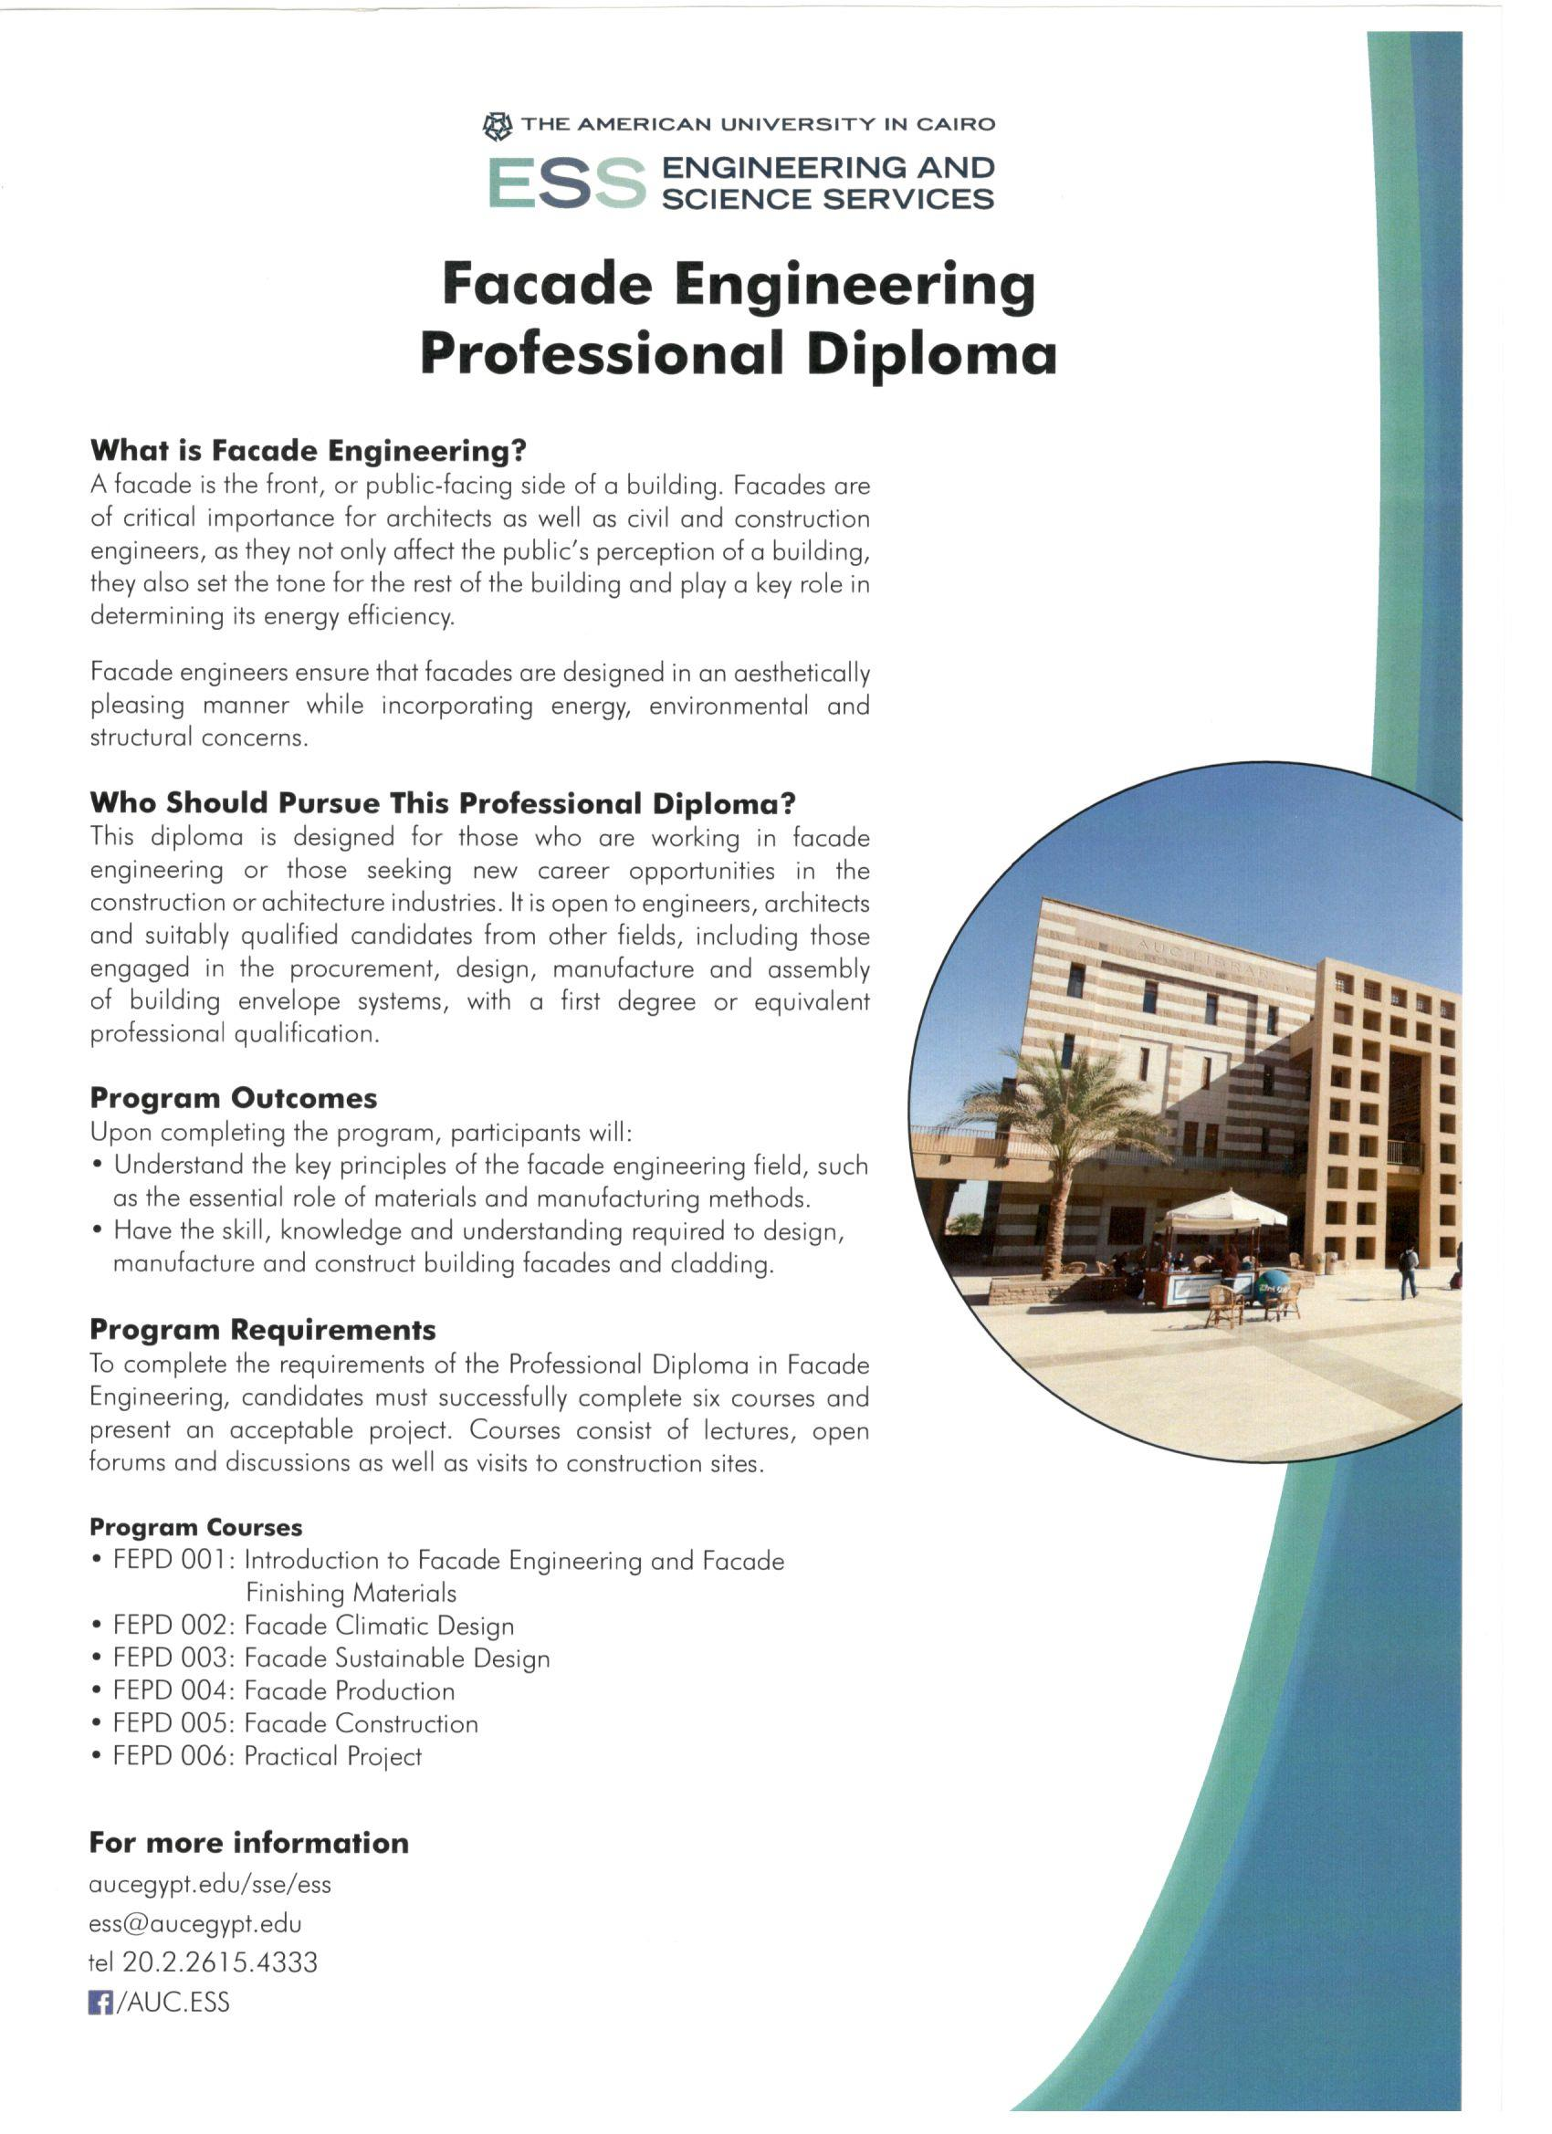

MEG Core Team:
Dr. ADEL ANWAR EID, Chairman
consultancy and instructor for Engineering and Science services “E.S.S.” at the American University in Cairo “AUC” for the Façade Professional Engineering Diploma. The first façade professional diploma in the MENA region certified by the American university.

Slide 26
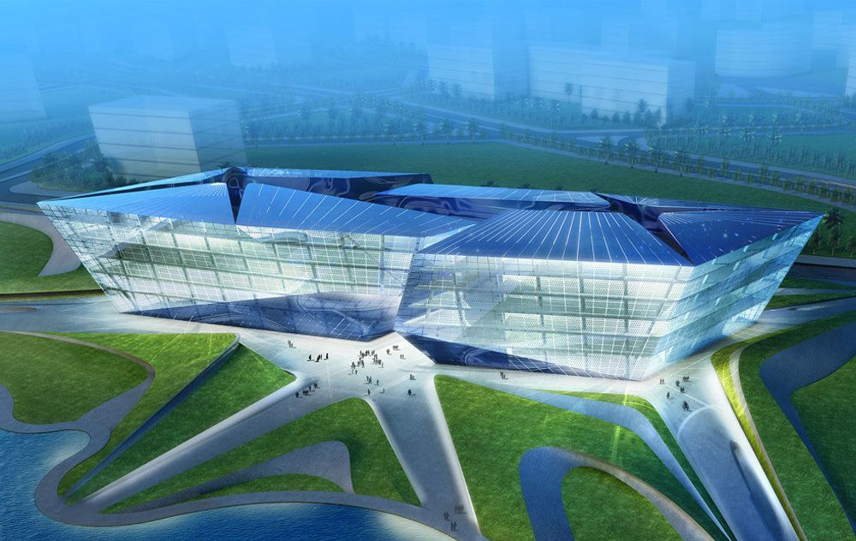
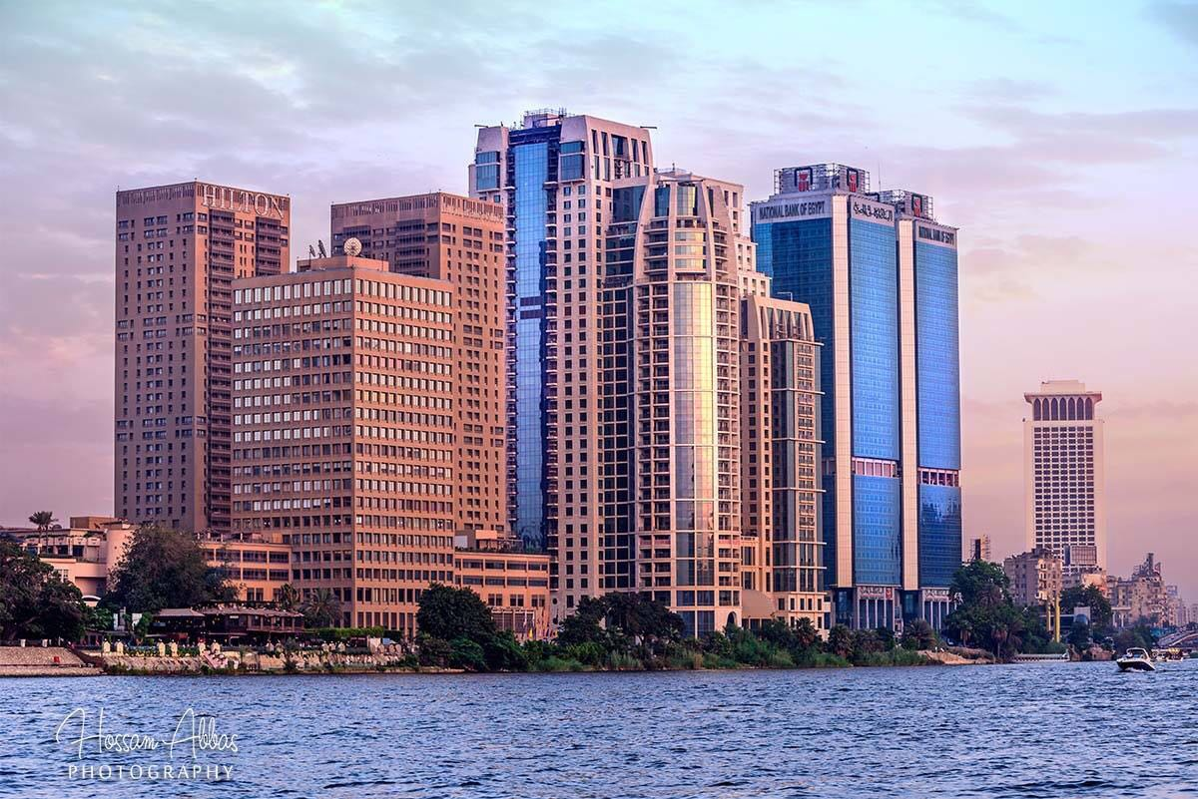
MEG Core Team:
Dr. ADEL ANWAR EID, Chairman
Extensive experience in façade engineering gained through working with international companies in various positions involving facade construction and design processes; introducing new strategies and planning systems that lead to decrease in project delivery durations; working in projects designed by prestigious consultants such as ZAHA HADID, NORMAN FOSTER, MICHEL GRAVE, NIKKEN SEKKEI, HOK, ATKINS, WATG, & WZMH and with prestigious façade consultants such as RAMBOLL, ARUP, MEINHARDT, HEITMANN & ASSOCIATES, ROBERT NANSTEEL, WHITBY & BIRD, WINTECH, & ETIENNE WATELET over thirty years.

Slide 27
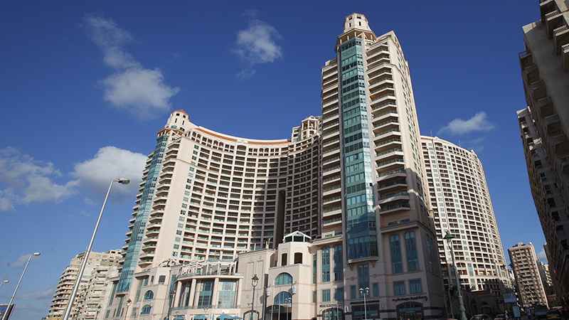
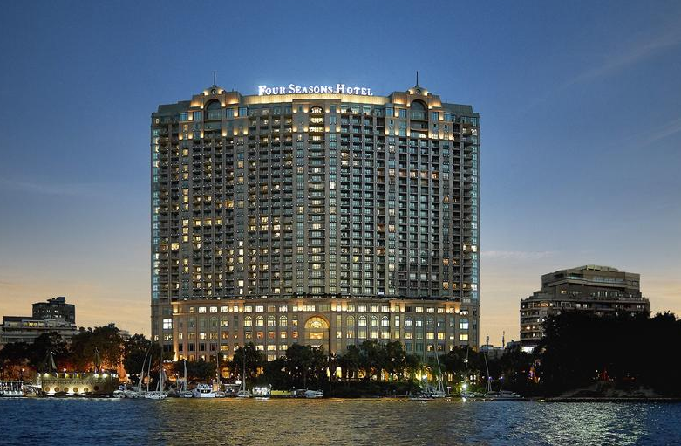
MEG Core Team:
Dr. ADEL ANWAR EID, Chairman
All these projects were designed according to international codes & standards, including, hotels, airports, office buildings, residential compounds, palaces, and educational buildings.
Contributes by publishing several technical articles in international engineering magazines. Hold, manage, and speaker for several international conferences.

Slide 28
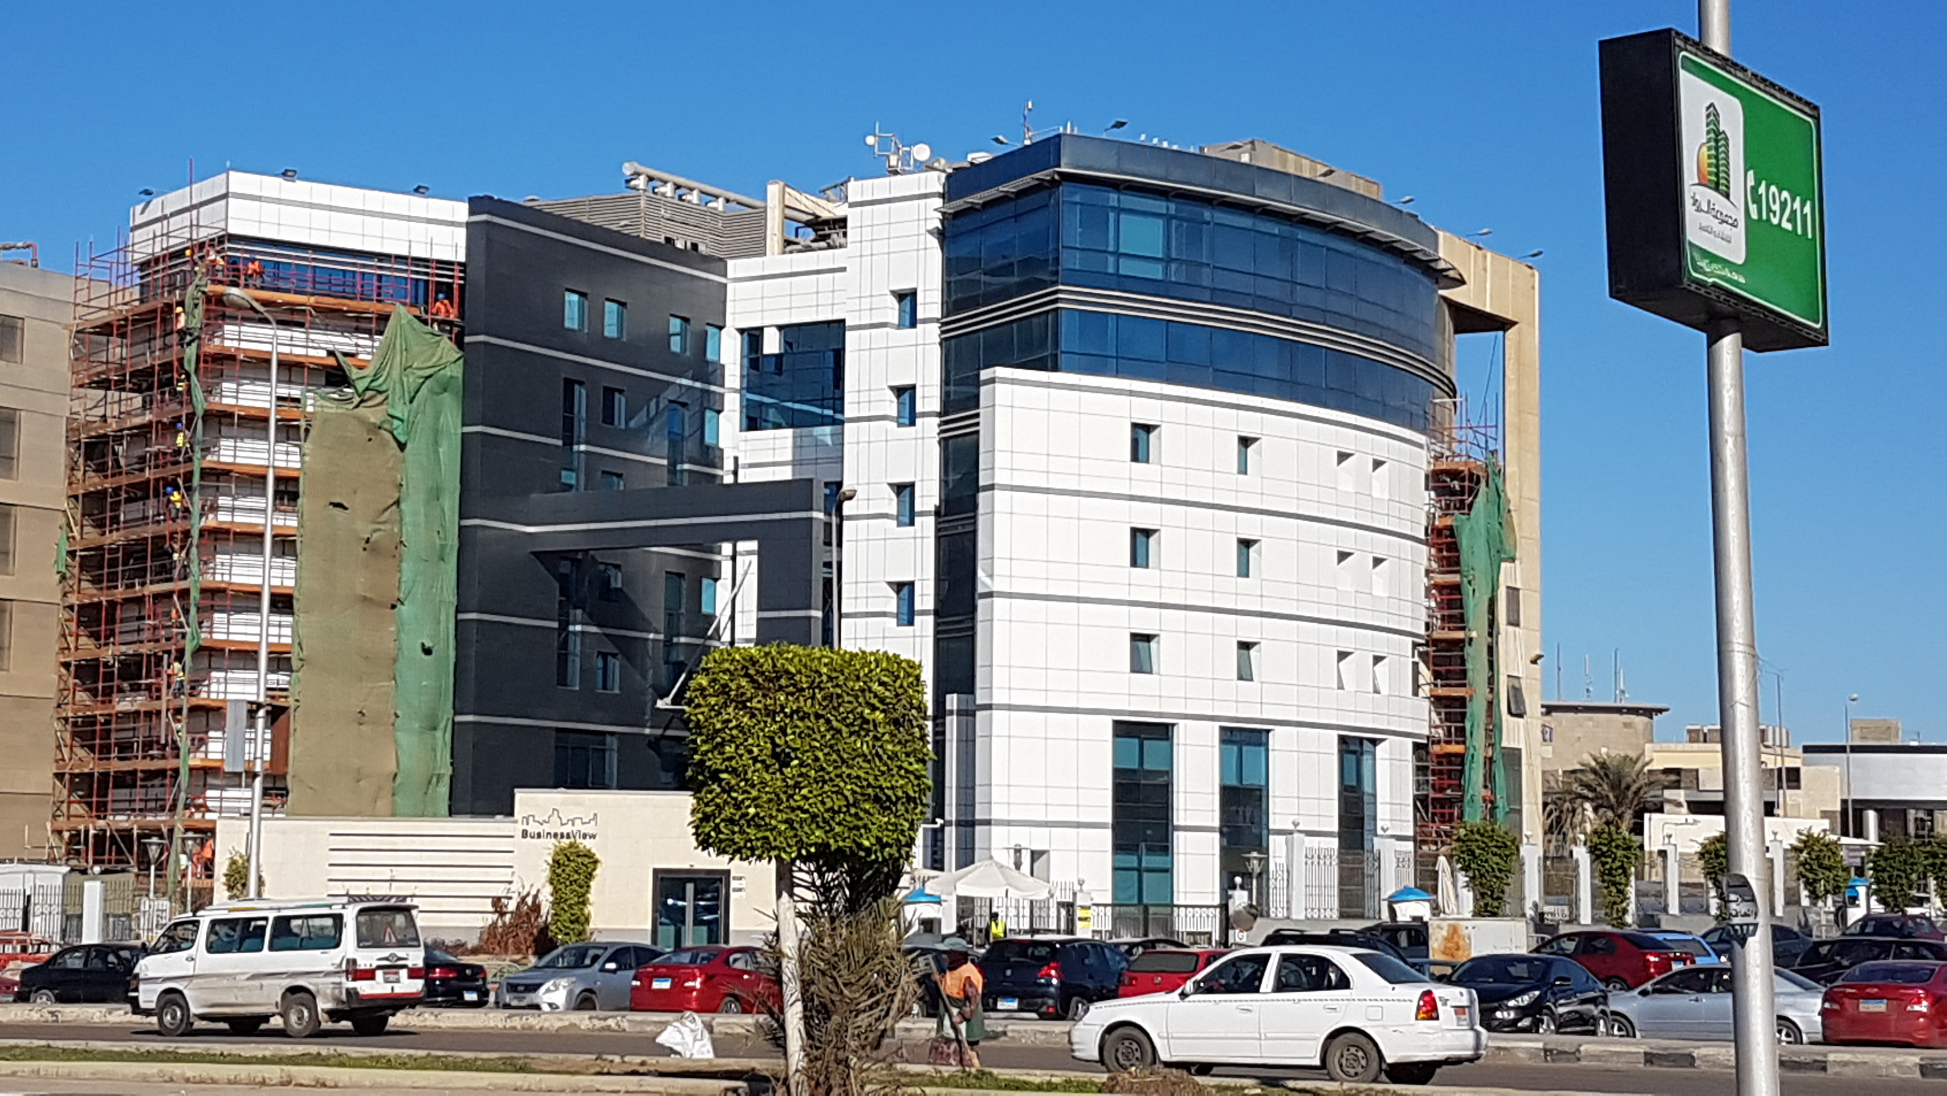
LIST OF PROJECTS BY MEG

Slide 29
MEG PROJECTS LIST
Façade Consultancy
All the below listed projects are designed by other architect and MEG role was to cover all engineering scope of work and supervision.
EMAAR SQUARE, UPTOWN, EMAAR, TURNER, façade consultancy and value engineering.
ROD EL FARAG BRIDGE, Glazed footbath, The Arab Contractors, Façade consultancy, Project and construction management.
OFFICE BUILDING, CONGO, GLASSCON, Dimitri G., façade engineering, structural calculation, value engineering, and shop drawings.
SHELL office building, New Cairo, 90th road, Façade Facelift due to structural threating by falling stone cladding and façade leakage.
AESW site inspection, site field construction.
BGP Camp, site field construction.
BUREAU 175, El Shams, 90th road, project management.

Slide 30
MEG PROJECTS LIST
Façade Consultancy
BUREAU 85, EVEREST, New Cairo, façade consultancy.
EGA, Mercedes assembly factory, 6 of October city, Fire safety plan.
UNISUN 2, New Cairo, 90th road, engineering assessment, structural calculation, stone cladding and curtain walling technical design.
AUDI BANK, REDCON, 90th road, double skin façade.
ABC BANK, REDCON, 90th north road, Façade facelift, GFRC cladding using cat walk at three facades and giant GFRC cladding supported at three point at main façade.
DIPLOMATIC HOSPITAL, SHUTTERING, façade design and construction supervision.
NEW CAIRO BUSINESS HUB, REDCON, engineering assessment.
BARAKA office building, BARAKA, New Cairo, 90th road, Façade cladding design and engineering including the BMU design.
KIAN, TECHNO FRAME, Façade engineering and structural calculation.

Slide 31
MEG PROJECTS LIST
Façade Consultancy
NEW CAPITAL CITY, GAMA, Ministry Buildings, façade consultancy.
NEW CAPITAL CITY, KEMET, Control Buildings, façade consultancy.
NEW CAPITAL CITY, FINELINE, Ministry Buildings, façade consultancy.
MADINATY, FINELINE, MALL E, Steel structure, façade cladding, construction management and supervision.
GEORGIA HOTEL, Mr AABED RAMSIS, Façade engineering.
SARAYA FACTORY, new factory establishment, façade consultancy.
MALL 9, EL REHAB CITY, FINELINE, façade consultancy.
BERENICE INTERNATIONAL AIRPORT, AL ADAWY, Façade cladding Structural calculation.
MANSOURA 1, PRESIDENTIAL PALACE, AL ADAWY, Skylight structural calculation and engineering.

Slide 32
MEG PROJECTS LIST
Façade Consultancy
QATAMIYA HEIGHTS COMPOUND, VILLA 670, Hashimi cladding engineering assessment, structural calculation, façade consultancy.
MADINATY, MALL C, ACC, steel structural cladding, GFRC/ GFRP cladding, and façade engineering.
FOUKA BAY, North Coast, Dr Aziz Ekram, Curtain walls structural calculation and engineering.
SODIC, WESTOWN, SIX WEST, COMMERCIAL FACADE DESIGN, facade consultancy.
NEW CAIRO OFFICE BUILDINGS, ACC, skylight and curtain walling structural and engineering design.
EMIRATES GROUP, AWAWA PANELS, sand trap, acoustical barriers, and acoustic louvers technical design.
ABITAL, CANEX, aluminum system design.

Slide 33
MEG PROJECTS LIST
Façade Consultancy
PALLADIUM MALL, INJAZ, 6 of October, façade engineering design, shop drawings, structural calculations, and façade project management.
ROD EL FARAG BRIDGE, Glass footbath redesign, construction and project management.
NEW CAIRO HEAD OFFICE, ACC, Skylight design.
AL ALAMEIN TOWERS, Frameless handrail system design, testing and application.
METRO STATIONS, Arab Contractors, Design management and coordination.
AUBE BANK, Façade Engineering Assessment & Construction Management.
TAJ CITY, ACE, CW, Windows & Doors structural integrity and technical evaluation.

Slide 34
MEG PROJECTS LIST
Office Buildings:
Al Moatasem office building
ECCT office building, 90th Southern road, architectural and interior design.
SHELL office building, 90th Southern road, Façade Engineering Consultancy.
UNI-SON 2 office building, 90th Southern road, Façade Engineering Consultancy.
BARAKA office building, 90th Southern road, Façade Engineering Consultancy.
REDCON office building, 90th Southern road, Façade Engineering Consultancy.
NBE Bank, MEP design and shop drawing, Nile cornice, Cairo.
ABC Bank, Façade Engineering Consultancy, Redcon, 90th Northern Road, New Cairo.
AUBE Bank, Façade retrofitting, 90th Southern Road, New Cairo.

Slide 35
MEG PROJECTS LIST
Educational:
Dar ELelm International School, LEED Certified
Hospitals & Health Care:
Awara Medical Tower
Al Shourouk hospital 1550 m2
Medical city hospital & Royal care
Ashraf El Shahawe medical center.
Medical Center, Nasr city.
Hotels:
Intercontinental touristic village, Hurgada, AYALA Middle East.
DELTA 4 stars hotel, Hurgada.
Isis Travel Agency, Staff Housing.

Slide 36
MEG PROJECTS LIST
Luxury Palaces:
AbdElsalamHigazy Palace, Al shourbagy, Cairo- Alex. Agriculture road.
Mohamed Awara Palace, Cairo alex desert road.
Mrs. Zeinab El Sayed El Far, 6th of October.
Villas:
Mr Ahmed Madkour, Al Obour city
Mr Ahmed Osman, 6th of October
Mr Ahmed Sami, 6th of October
MrAlaaKishk, 6th of October
Mr Mohamed Gazar, Villa refurbishment.
Mr Mohamed Gazar, new Villa

Slide 37
MEG PROJECTS LIST
Villas:
Mr Mohamed El Halaby villa
Mr Mohamed Awara villa, Cairo Alex desert road
Mr Mostafa Abou El Naga, tanta.
Mr Mostafa Bashir, tanta.
Mrs. Magda Mohamed Ahmed, Al Obour City.
Mr Saad Farag villa Compound, Alex.
Mr Wagieh shafik Farag, Al Sadat City.
Residential Towers:
Dr. Adel Khalifah residential tower.
Dr. Saed Saafan residential tower.

Slide 38
MEG PROJECTS LIST
Residential Towers:
Flower tower, residential tower.
Royal tower, residential tower.
Mohamed Bar Residential tower
El Shami office residential tower, Total built up area 6444 m2
El Shami commercial residential tower, Total built up area 8496 m2
El Bana residential tower.
Abd El Reheim El Gammal residential tower.
Al forqan residential tower.
Dr Galila residential tower, façade engineering, Al Mohandseen
Mr. Ibrahim El Fawi, residential tower.
Mr. Mohamed Bar residential tower, Stadium road, Tanta

Slide 39
MEG PROJECTS LIST
Residential Towers:
Mr. Mohsen Farag, Façade design, residential tower.
Mr. Mohamed Orieby, Tanta, residential tower.
Mr. Saad Farag, Agamy, Alex, residential tower.
Mr. Saad Farag, al Mansourah residential tower.
Mr. Shafik saad Abdou residential tower.
Mr. Abd El Salam Higazy, Stadium street, Tanta, residential tower.
Interior Decoration:
AL GUEZIRA COMPOUND, Mr Alaa El Gharabawi
FSH Luxor mockup room.
Joval shop, branding, interior design, and supervision.

Slide 40
MEG PROJECTS LIST
Interior Decoration:
Al Rabouah chalet, Mr. Mohamed Bar
Villa Mr. Mohamed Bar, entrance interior design, façade redesign, interior designs for different apartments.
Egypt Food shop.
Mr Mostafa Awni, pent house design
Al rabouah Compound, weekend shale interior design.
SFC Bahra Franchise, shop interior design.
Mr. Mostafa El sherbini Apartment.
Mr. Osama Ouf apartment, Nasr City, interior design, construction supervision.
President office at Slaughterhouse, Mr. Abd El Salam.

Slide 41
MEG PROJECTS LIST
Landscape Projects:
Abd Elsalam Higazy palace landscape.
Mohamed Awara palace landscape.
Mosques:
Mr. Mohamed Moenes El Shahat, land area: 1297 m2, BUA: 506 m2, new Cairo, Cairo.
Al Damati mosque, BUA: 1040 m2,tanta, El Gharbia.
Abd El Samea El Shami Mosque, BUA: 2750 m2, Al Mahala.
Kom Hamadah Mosque, Kom Hamadah, BUA: 828 m2.
Mr. Mohamed Awara Mosque.
Tala Mosque, BUA: 876 m2.

Slide 42
MEG PROJECTS LIST
Industrial Projects:
El Sadek Revas Marble and Wood Factory, El Sweis.
Awara factory façade redesign, Tanta.
Awara juice factory, 6th of October.
Egypt Foods factory refurbishment.
Mineral water factory, El Sadat City, Abd El Salam Higazy
Saed El Sallab, storage and administration building, New Cairo, Industrial Zone.
Custom made façade systems designer.

Slide 43
MEG CATEGORIES OF SERVICES
Categories of Services
Architectural & Engineering design.
Value Engineering.
Façade Technical design & Engineering.
Construction management.
Project management.

Slide 44
OTHER SERVICES COVERED BY MEG

Slide 45
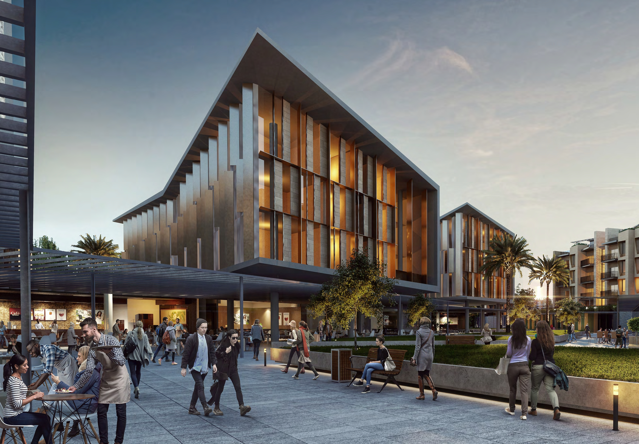
Other Services Covered By MEG
Engineering's Design Services:
Appraisal.
Strategic Brief.
Outline Proposals.
Detailed Proposals.
Final Proposals.
Production Information.
Tender documents.
Tender Action.
Mobilization.
Construction to Practical Completion.
After Practical Completion.
SODIC WESTOWN - BLOCK 6 - OFFICE BUILDINGS

Slide 46

Any Questions ?

Slide 47

THANK YOU FOR YOUR ATTENTION

